Slide 1
concurrent collections and Their Internal Implementations
ConcurrentHashMap, CopyOnWriteArrayList, CopyOnWriteArraySet

Slide 2
Why concurrent collections?
Today we’ll understand why these collections exist, how they work internally, and when to use each one. Problem with normal collections
Multiple threads accessing shared collections can cause:
data inconsistency
race conditions
ConcurrentModificationException
poor performance with coarse locking

Slide 3
Traditional solution vs modern solution
Synchronized Collections vs Concurrent Collections
Content:
Collections.synchronizedMap(...)
Collections.synchronizedList(...)
Entire collection often locked for operations
Less scalable under high concurrency
Vs:
ConcurrentHashMap
CopyOnWriteArrayList
CopyOnWriteArraySet

Slide 4
ConcurrentHashMap
What is ConcurrentHashMap?
Thread-safe map for concurrent access
Allows multiple threads to read and update efficiently
Better scalability than synchronized HashMap
summary:
CHM is designed for high concurrency without locking the entire map.

Slide 5


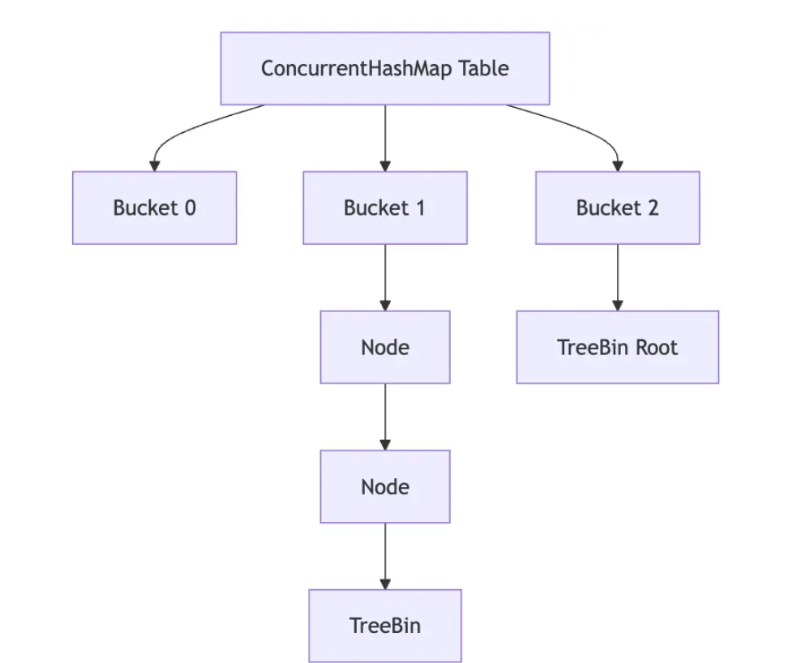
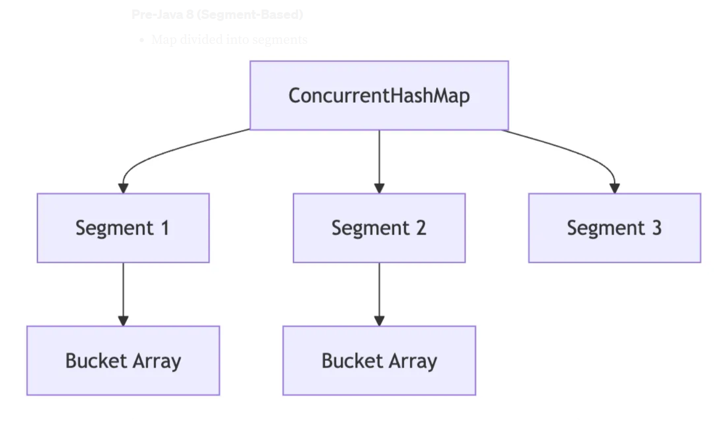
CHM Internal Working
Data stored in an array of buckets
Each bucket may contain:
linked list
tree (when collisions are high)
Reads are mostly lock-free
Updates use fine-grained synchronization/CAS
Java 8 removed segment-based design from older versions
Important note:
In Java 7 → segment-based locking
In Java 8+ → bucket-level / node-level synchronization + CAS

Slide 6
HashMap vs Hashtable vs ConcurrentHashMap
Collection | Thread-safe | Locking style | Scalability
HashMap | No | None | High but unsafe
Hashtable | Yes | Whole table lock | Low
ConcurrentHashMap | Yes | Fine-grained/CAS | High
HashMap: no lock
Hashtable: one giant lock
CHM: multiple small lock zones

Slide 7
When to use ConcurrentHashMap
Shared caching
Frequency counters
Session storage
Real-time metrics aggregation
Best when there are frequent reads and updates by many threads

Slide 8
CopyOnWriteArrayList
Thread-safe variant of ArrayList
On every write operation:
creates a new copy of the internal array
modifies the new array
replaces the old array reference
Excellent for read-heavy workloads, expensive for write-heavy workloads

Slide 9
How CopyOnWriteArrayList Works
Internally uses an array
Read operations:
no locking needed
very fast and safe
Write operations:
lock
copy entire array
perform update
publish new array
Ex - Array v1: [A B C] Write add(D) New array v2: [A B C D] Readers continue on old snapshot until switch

Slide 10
Why iteration is safe in COWAL ?
Iterator uses a snapshot of the array at the time iterator was created
So concurrent modification does not throw ConcurrentModificationException
Iterator does not see later updates
Example
Thread 1 iterator sees [A B C]
Thread 2 adds D
Thread 1 still sees [A B C]

Slide 11
COWAL trade-offs
Pros and Cons of COWAL
Pros:
very safe iteration
no ConcurrentModificationException
excellent for frequent reads
Cons:
expensive writes
high memory copying overhead
not suitable for large lists with frequent mutation
Use cases:
subscriber lists
configuration snapshots
event listener registry

Slide 12
CopyOnWriteArraySet
Thread-safe set built on top of CopyOnWriteArrayList
Maintains uniqueness
Copy-on-write behavior for writes
Great for read-mostly set use cases
COWAS = copy-on-write list + set uniqueness.

Slide 13
COWAS internal implementation
Backed internally by CopyOnWriteArrayList
Before adding, checks if element already exists
If absent:
copy array
add element
publish new snapshot
Current snapshot: [A B C] Add B → already exists → no change Add D → new copied snapshot [A B C D]

Slide 14
COWAS use cases and limitations
Use cases:
listener registries
observer/subscriber sets
plugin/module tracking
read-heavy unique collections
Limitations:
costly writes
linear search for existence checks
not ideal for write-intensive workloads

Slide 15
CHM vs COWAL vs COWAS
Feature | ConcurrentHashMap | CopyOnWriteArrayList | CopyOnWriteArraySet
Type | Map | List | Set
Thread-safe | Yes | Yes | Yes
Best for | concurrent reads/writes | read-heavy list | read-heavy unique set
Read performance | High | Very high | Very high
Write performance | Good | Expensive | Expensive
Iterator behavior | Weakly consistent | Snapshot | Snapshot
CHM → weakly consistent
may reflect some updates during iteration
no ConcurrentModificationException
COWAL / COWAS → snapshot
sees old array snapshot only
never sees later modifications in same iteration
weakly consistent iterator in CHM
snapshot iterator in COWAL/COWAS

Slide 16
Which one should I choose?
ConcurrentHashMap
shared mutable key-value store
many reads and writes
CopyOnWriteArrayList
list is read far more often than modified
CopyOnWriteArraySet
unique elements, mostly reads, rare writes

Slide 17
Q & A ?

